Slide 1
SAR ADC Results
Anthony Garaffo(CID03) and Hector Morrell(CID08)

Slide 2
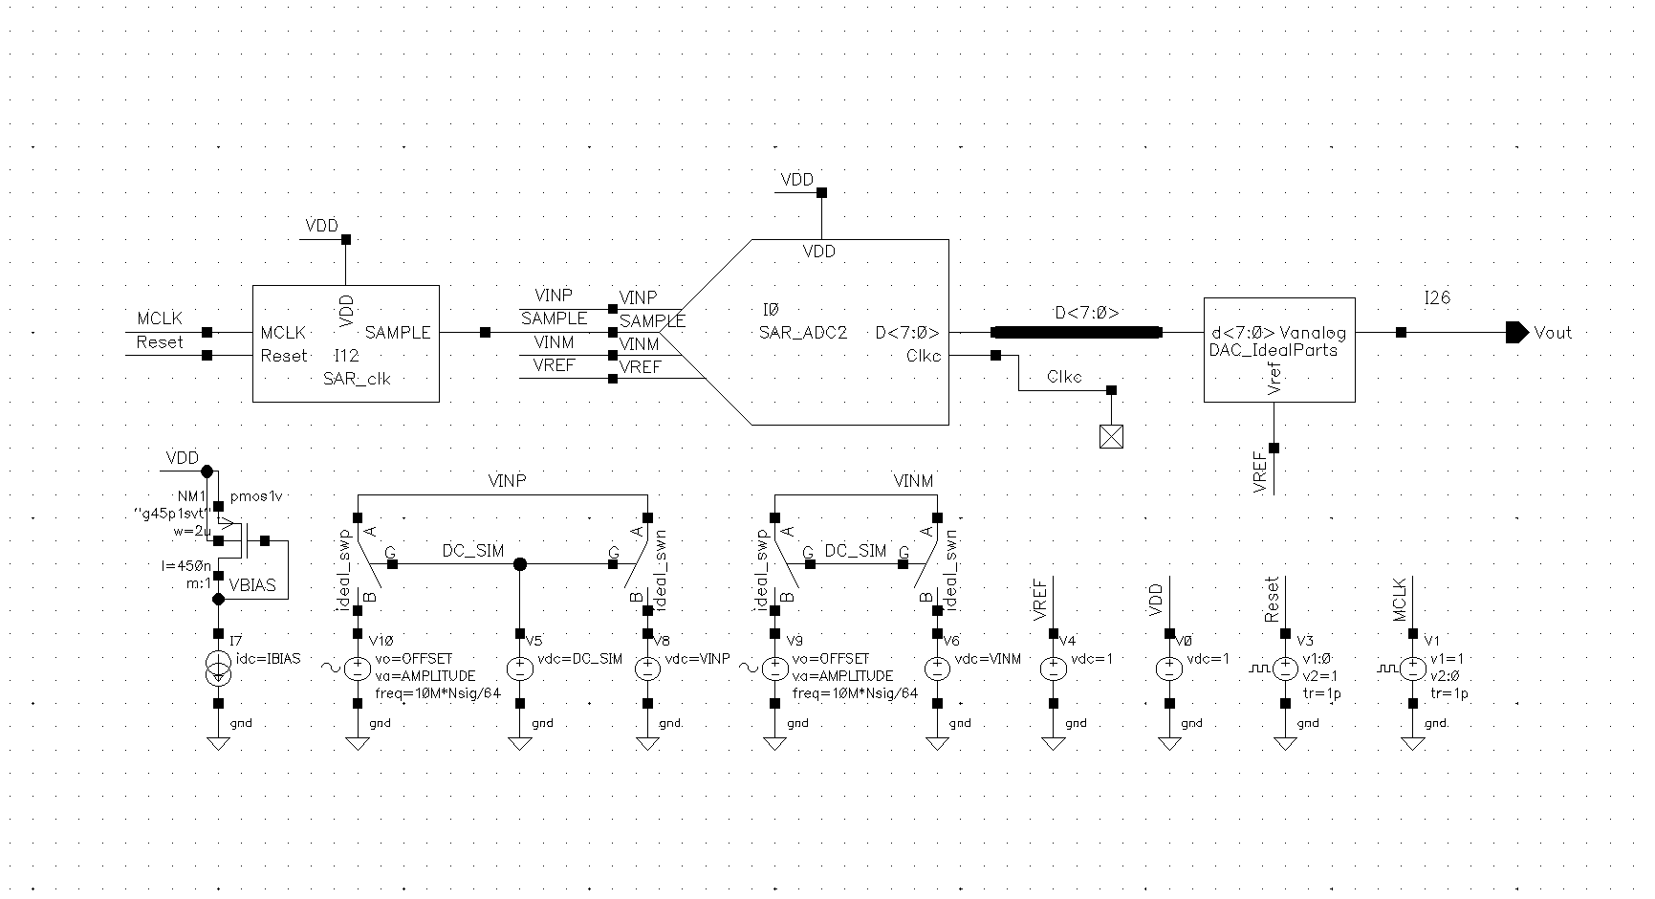
SAR ADC Test Bench

Slide 3
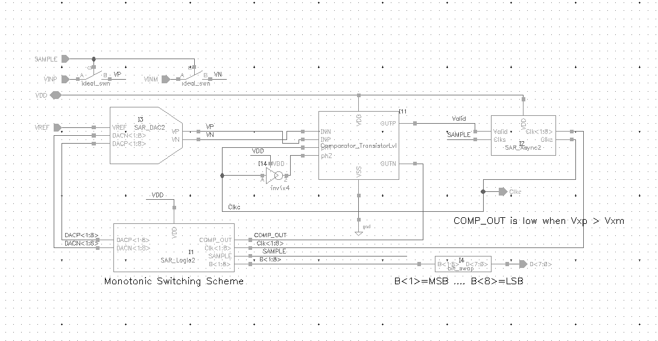
SAR ADC

Slide 4
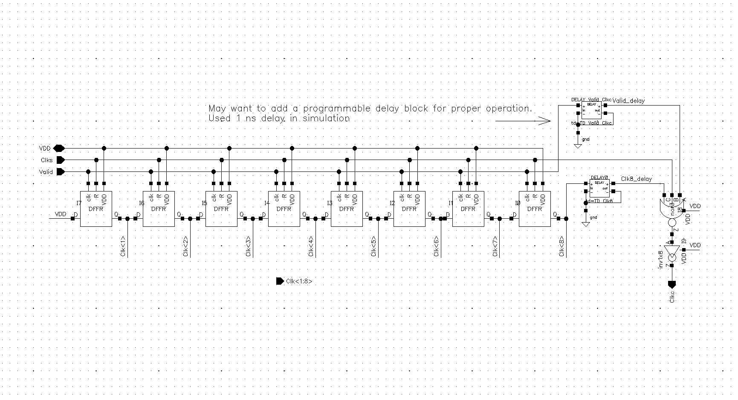
Asynchronous Clock

Slide 5
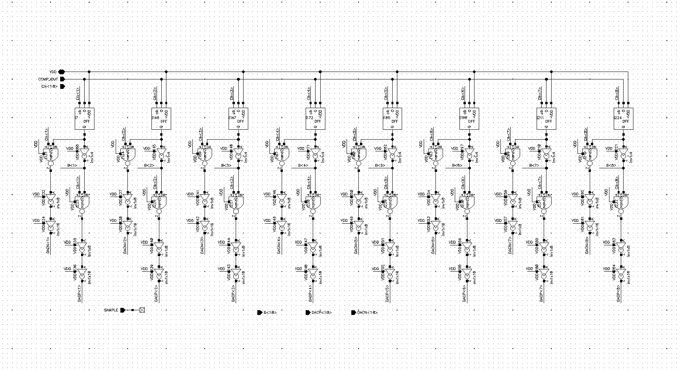
SAR Logic

Slide 6
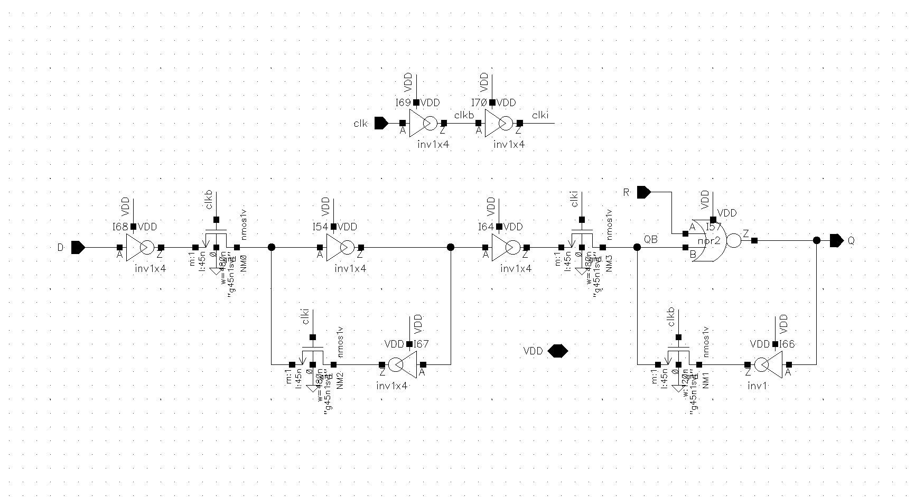
DRRF

Slide 7
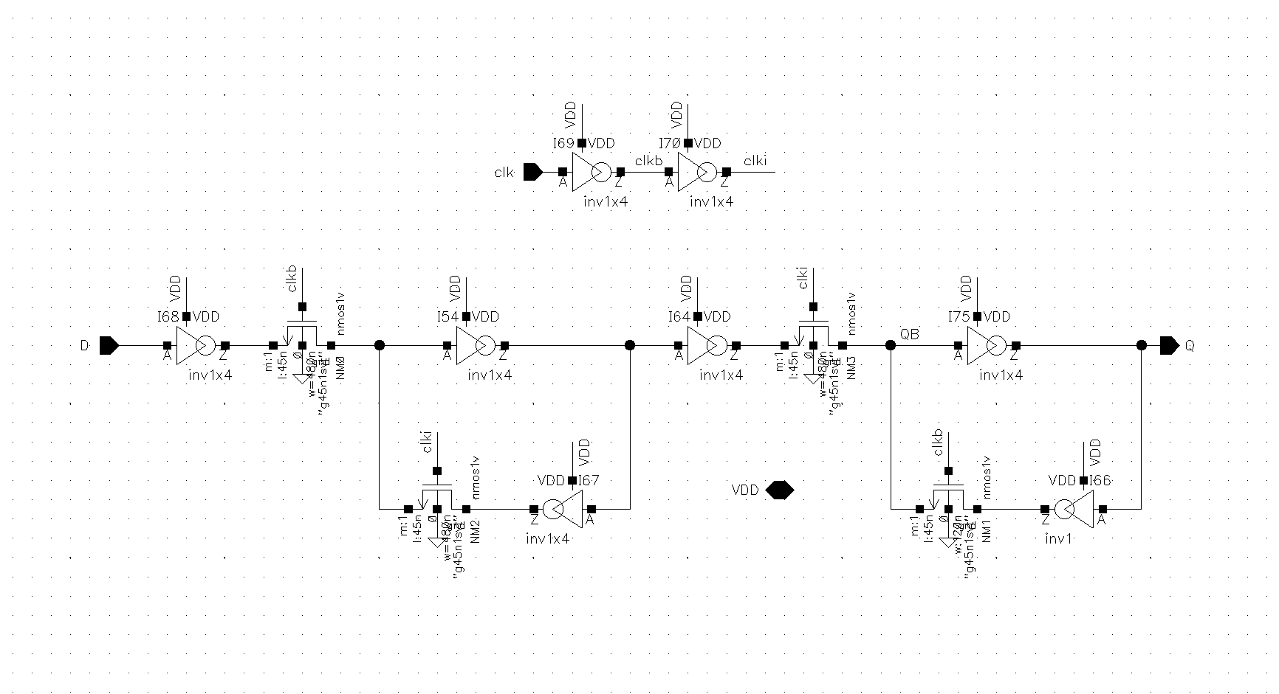
DFF

Slide 8
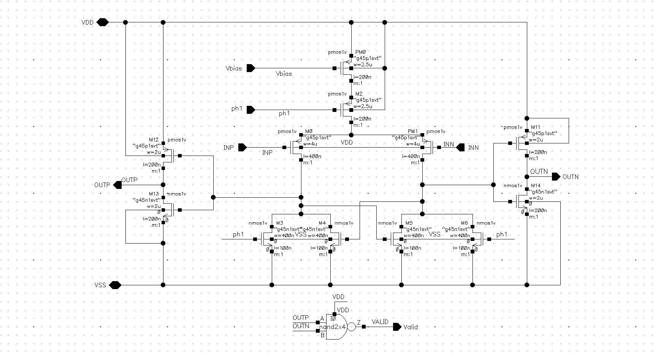
Comparator

Slide 9
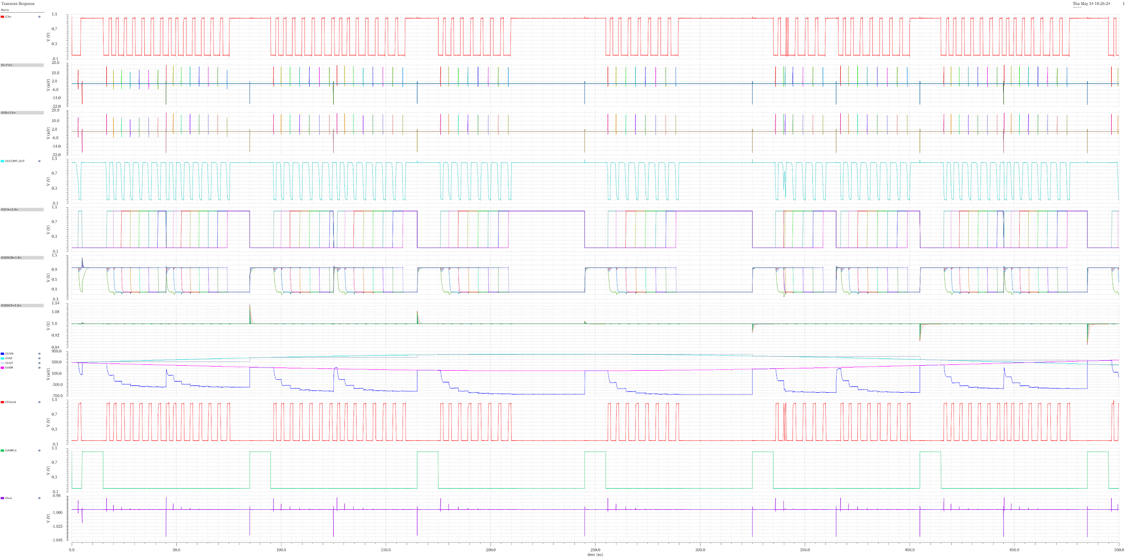
SAR ADC Output (AC Sim)

Slide 10
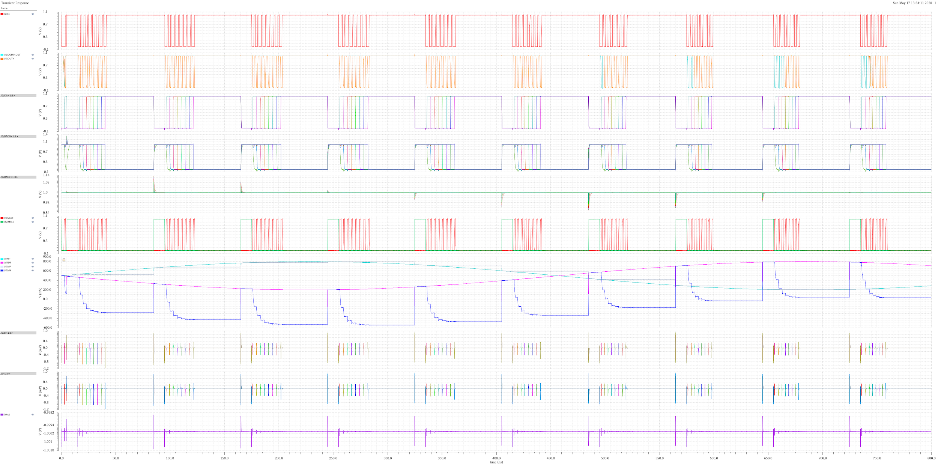
SAR ADC Output (DC Sim - White Background)

Slide 11
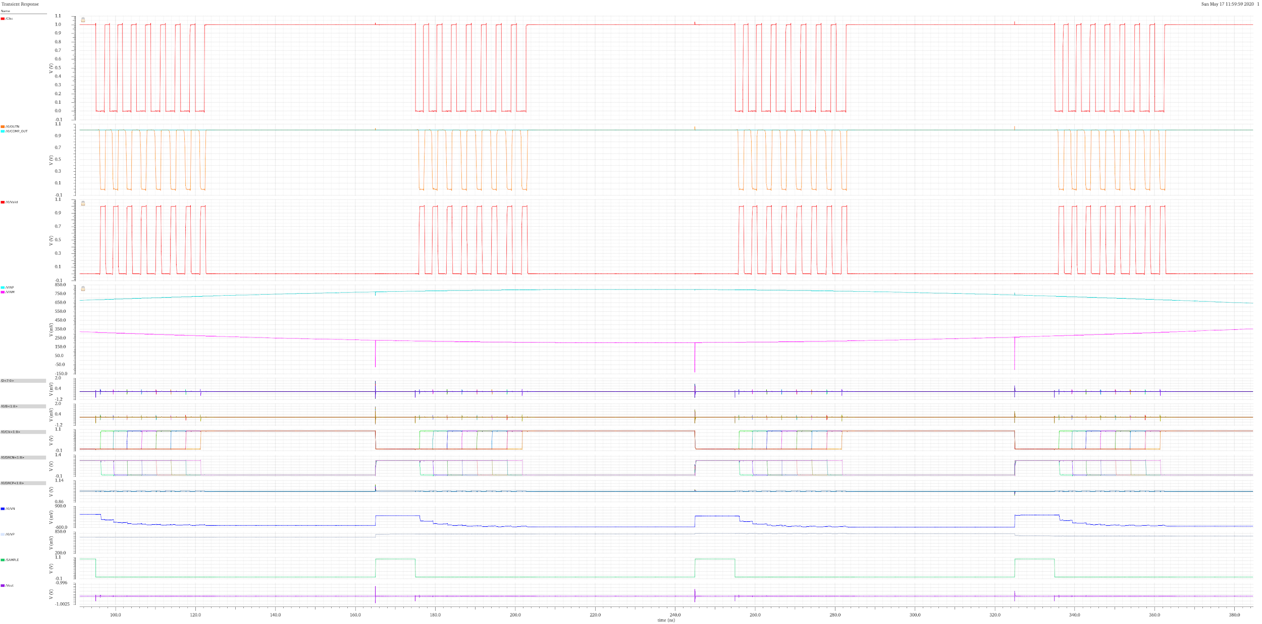
Comparator (Proof Latch works)

Slide 12
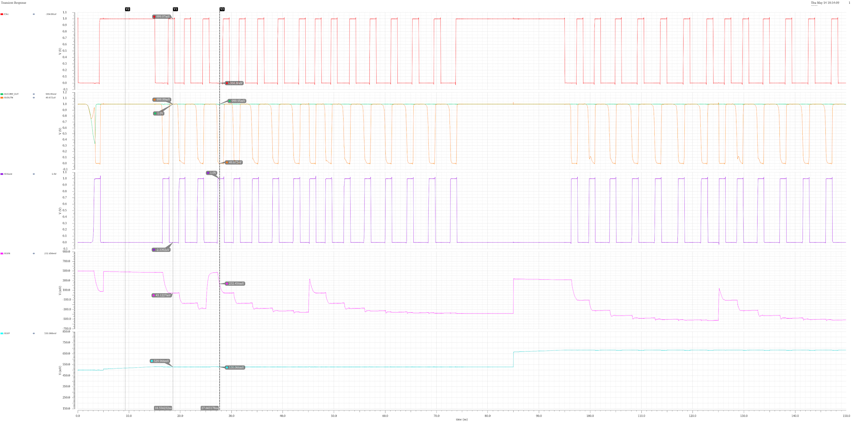
Clock Comparator Eval

Slide 13
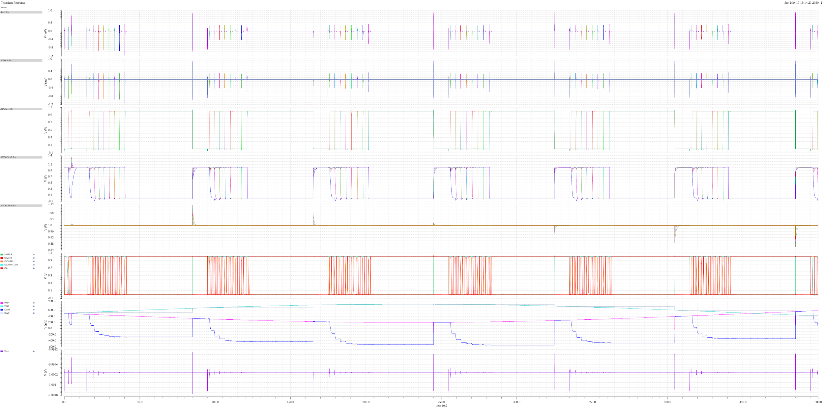
Digital Output

Slide 14
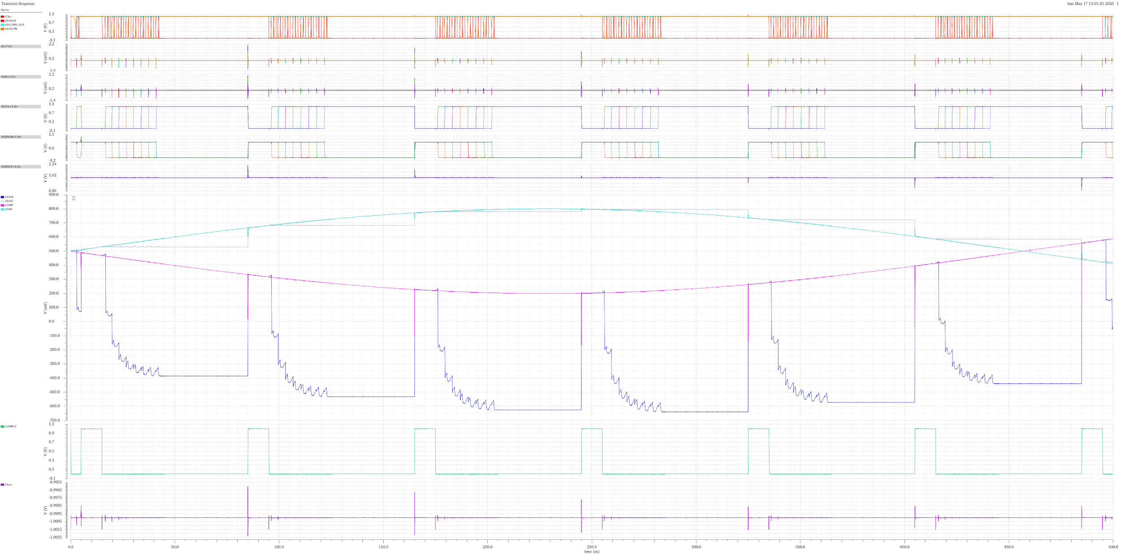
Changing CH/C0 to smaller capacitances

Slide 15
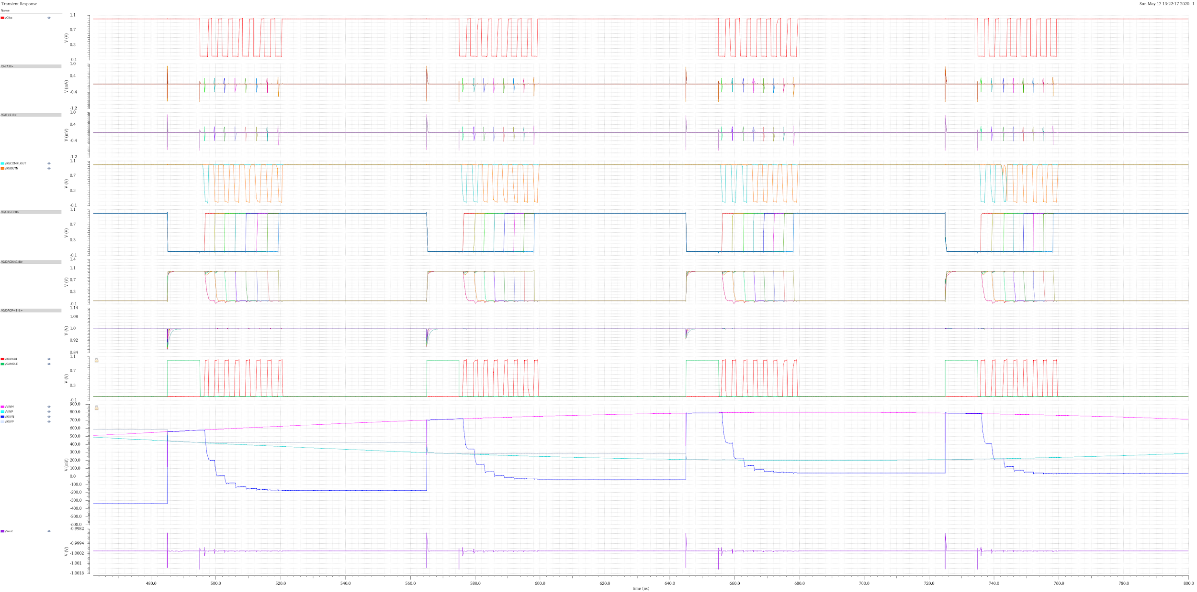
Close Up of Vm greater than Vp

Slide 16
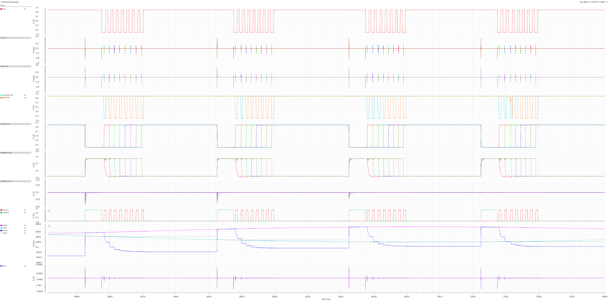
Close Up of Vm greater than Vp(2)

Slide 17
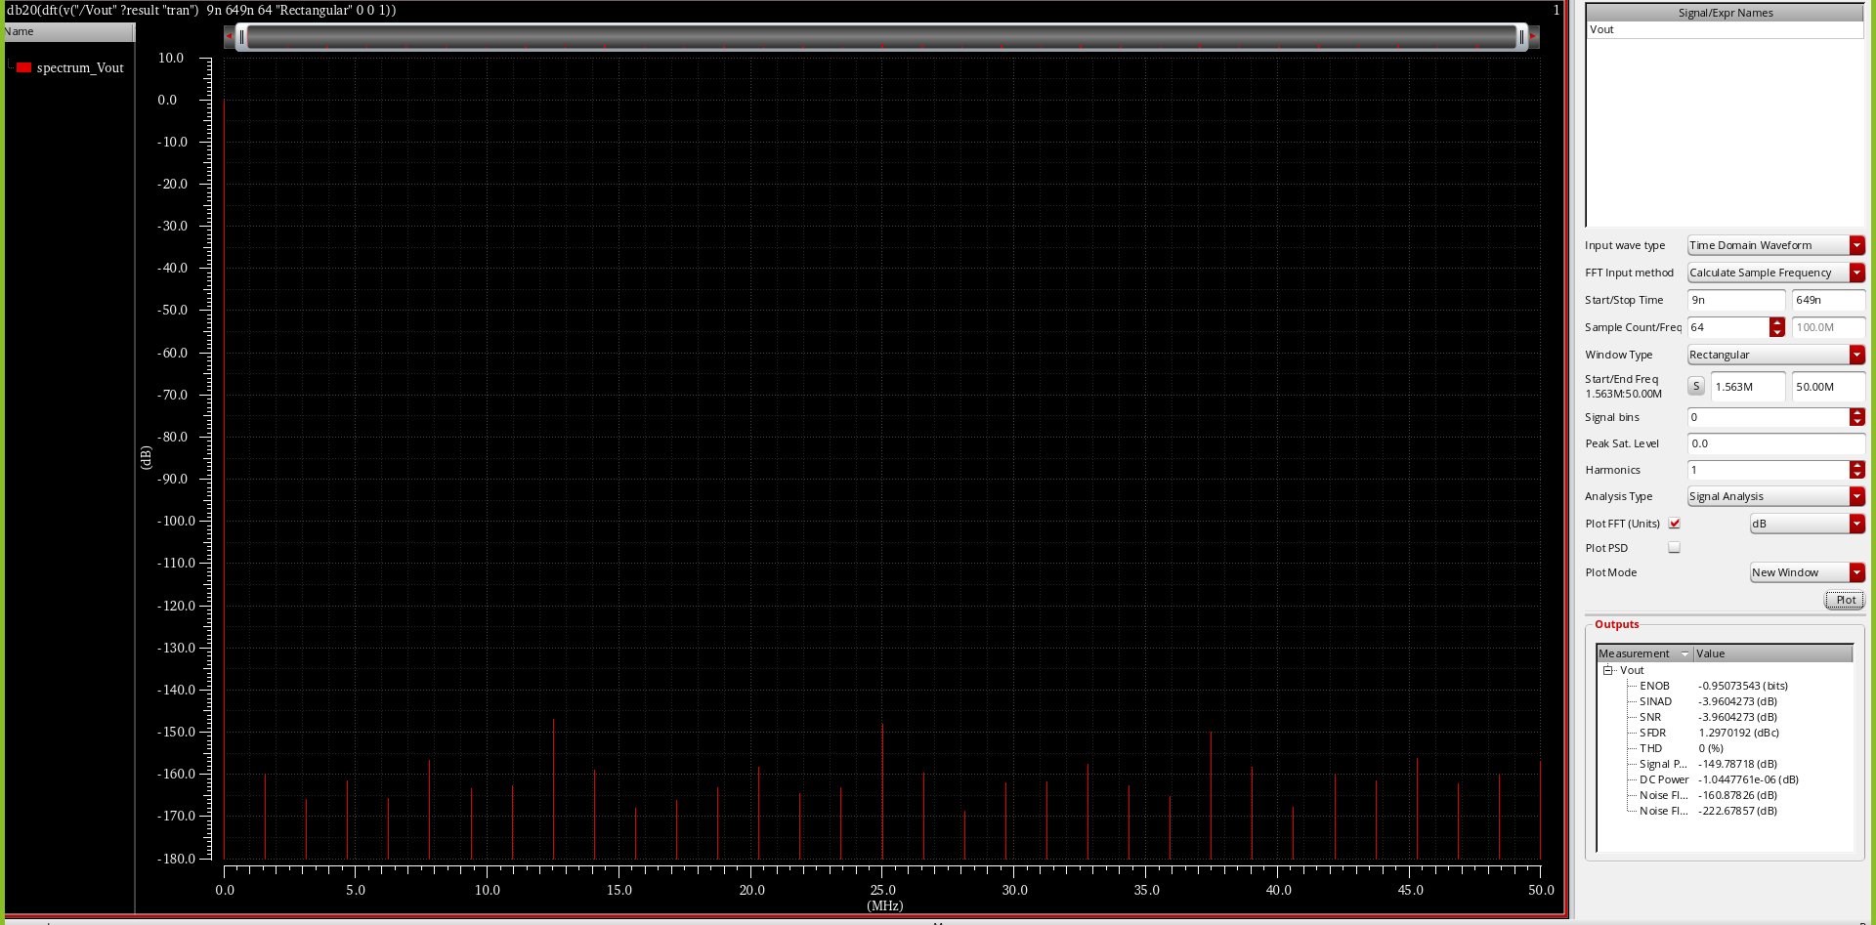
FFT of SAR ADC

Slide 18
SAR Logic
Verilog A Code

Slide 19
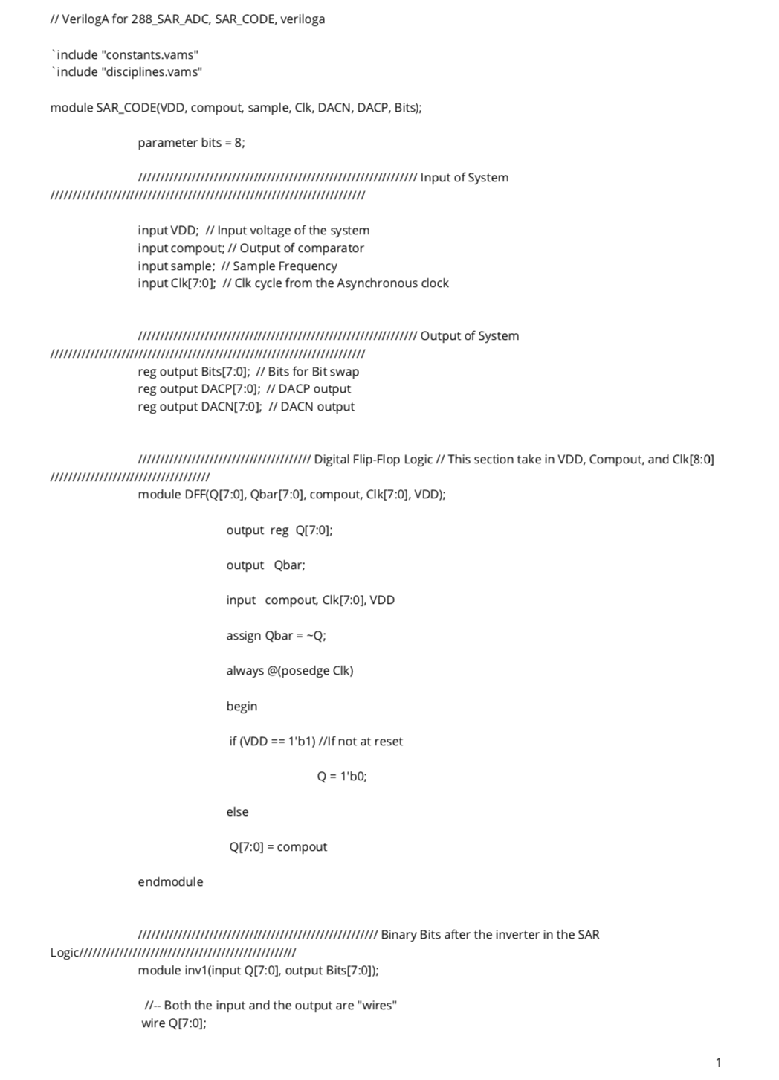

Slide 20
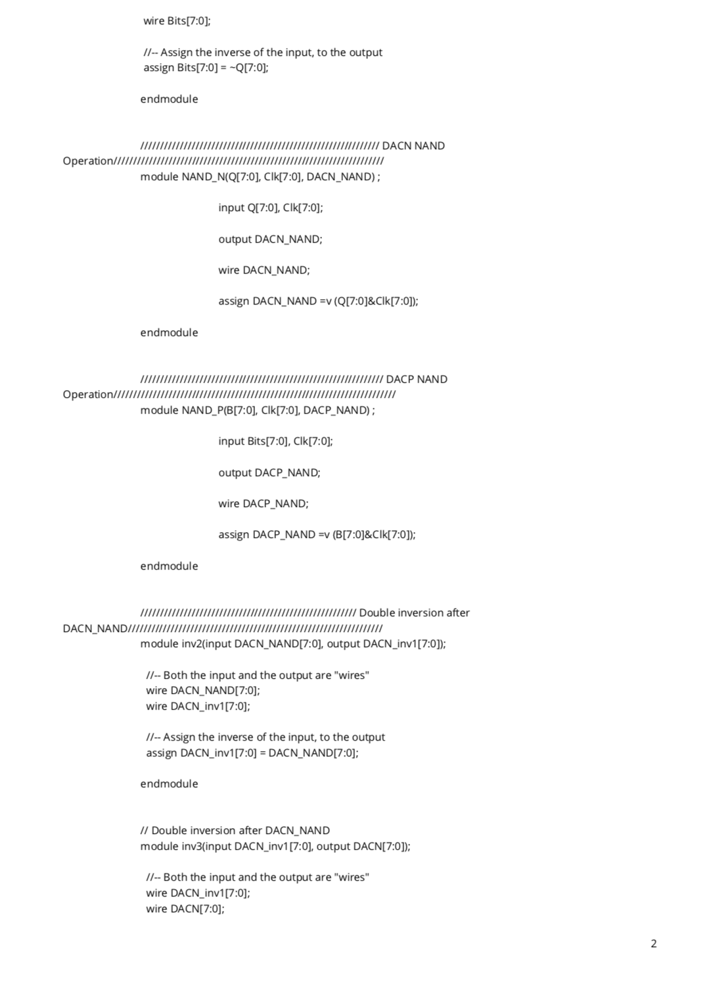

Slide 21
